Slide 1
SPLOST (Special Purpose Local Option Sales Tax) Public Hearing
August 12, 2013
7:00 PM
City Hall

Slide 2
What is SPLOST?
SPLOST stands for (Special Purpose Local Option Sales Tax)
SPLOST taxes represent 1 cent on the dollar
SPLOST will be on November ballot
SPLOST lasts 5 years

Slide 3
Possible SPLOST Projects

Slide 4
City Roads & Side Walks
Repaving of approximately 10 miles of city roads
$100,000 of sidewalk work
Culverts & Bridge Replacement of Chattanooga Street & Broomtown Road
Total Project Costs $1.6 million

Slide 5
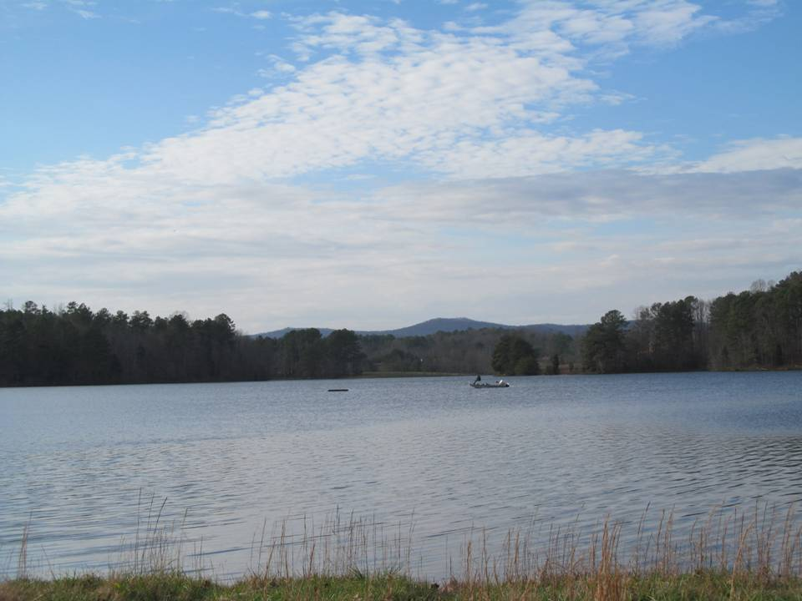
City Lake Project
To make City Lake more accessible and user accessible for the citizens of LaFayette.
City Lake Park
Boat Ramp
Fishing Pier
Total Project Costs $50,000

Slide 6
Splash Park at City Recreation Center
To create a place for families to enjoy the summer months without having to leave LaFayette
Total Project Costs $500,000

Slide 7
Ross Abney Stadium Project
Renovate Ross Abney Building into a Multi-Purpose Facility
Facility would be used for youth football, Frisbee Football and Festivals
Includes: new fencing, bathrooms & replacement of bleachers
Total Project Costs $150,000

Slide 8
Walking & Biking Trail Project
Rebuild the old Rotary Walking Trail to extend from the Housing Authority to the old High School Walking Track
Would consist of a 9 foot wide concrete path complete with benches, lighting & signage
Total Project Costs $100,000

Slide 9
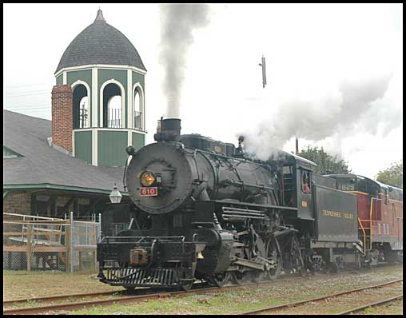
Train Depot Project
To establish a Train Depot in LaFayette for weekend train excursions
TVRA is willing to begin a historic train excursion to LaFayette, but must have a Depot to load & unload passengers
Train would bring 100-200 people per trip to shop & dine while in LaFayette
Total Project Costs $100,000

Slide 10
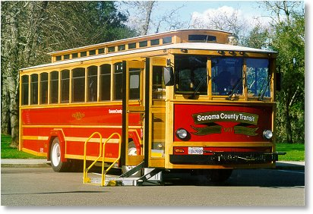
Travel Trolley
To establish a weekend travel trolley in LaFayette
Trolley Stops throughout town with stops at City Parks, Historical Sites, Businesses and other places of interest
Handicap Accessible
Total Project Costs $60,000

Slide 11
City Hall Upgrades
Bring City Hall up to date by
Paint
Roof Replacement
Replacement of A/C Units
Replace Furniture
Replace Flooring
Total Project Costs $150,000

Slide 12
Other Options
Police-Repeater Radio System $50,000
Library-Books to Teach (over 5 years) $50,000
City Hall-Replace outdated software $90,000
Total Other Options Cost $190,000

Slide 13
Possible SPLOST Project Lists (in order of slides)
City Roads & Side Walks $1.6 million
City Lake Project $50,000
Splash Park $500,000
Ross-Abney Stadium $150,000
Walking & Biking Trail $100,000
Train Depot Project $100,000
Travel Trolley $60,000
City Hall Upgrades $150,000
Other Options $190,000
Possible Project Totals $2.9 million

Slide 14
Thank you for your time and interest in your community.
Any Questions?
Please feel free to stay for the City Council Meeting to follow.

